Slide 1


AMONET: A Method for Detecting and Mitigating
the Data Rate Degradation due to Interference Over
Wireless Networks
Guohao Lan, Sangyup Han, Il-Gu Lee, and Myungchul Kim
School of Computing, KAIST
IFIP Networking
18th May 2016

Slide 2
Contents
Introduction
Related Work
Problem Definition
Proposed System: AMONET
Performance Evaluation
Conclusion and Further works

Slide 3
Contents
Introduction
Related Work
Problem Definition
System Design
Performance Evaluation
Conclusion

Slide 4
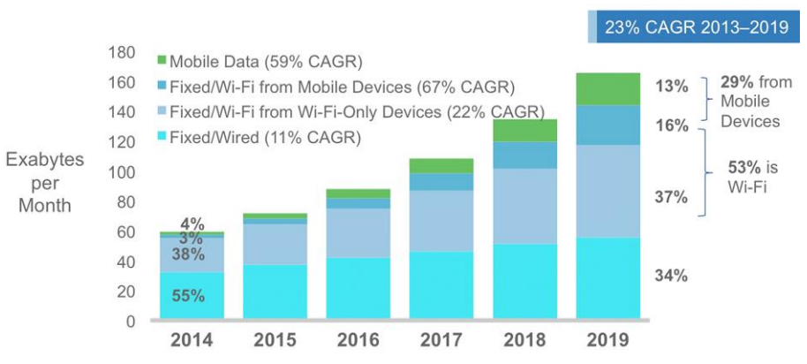
Growth of Wi-Fi networks
Reported by Cisco, the Wi-Fi traffic will account for 53% of IP traffic in the year of 2019.
Source: Cisco VNI Mobile, 2016
Notes:
According to the recent report by Cisco, the WiFi traffic from both mobile devices and WiFi only devices together will account for more than half
(which is 53%) of the total IP traffic by year of 2019, up from 41% in year 2014.

Slide 5
Growth of Wi-Fi networks (cont.)
Globally, total public Wi-Fi hotspots will grow sevenfold from 2015 to 2020:
From 64.2 million in 2015 to 432.5 million by 2020.
Total Wi-Fi home spots:
Will grow 56.6 million in 2015 to 423.2 million by 2020.
The deployment of Wi-Fi Access Points will become more denser and bring more co-channel interference.
Notes:
In more detail, the significant growth in WiFi traffic results from the increase of Mobile Stations (MS) and dense deployment of Wi-Fi Access Points (AP).
According to the report, the total public Wi-Fi hotspots will grow sevenfold from 2015 to 2020, that is, from 64.2 million in 2015 to 432.5 million by 2020.
In case of Wi-Fi home spots, it will grow 56.6 million in 2015 to 423.2 million by 2020.
However, the number of wireless channels is limited !!! Lead to more co-channel interferences and lower system throughput.

Slide 6
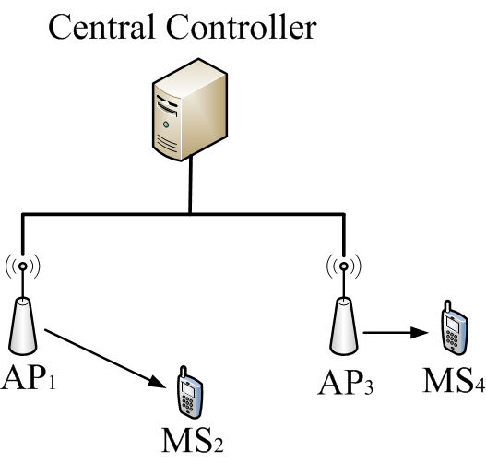
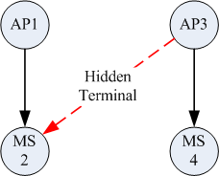
Interference Mitigation
Centralized Optimization of Wi-Fi networks:
Conflict Graph
Functionalities of the controller:
Channel assignment [1,2]
Power control [3,4]
Packet scheduling [5,6]
[1] Mishra, Arunesh, et al. "A Client-Driven Approach for Channel Management in Wireless LANs." Proceedings of IEEE INFOCOM. 2006.
[2] Rozner, Eric, et al. "Traffic-aware channel assignment in enterprise wireless LANs." Proceedings of IEEE ICNP 2007. 2007.
[3] Mhatre, Vivek, et al. "Interference mitigation through power control in high density 802.11 WLANs." Proceedings of IEEE INFOCOM 2007.
[4] Huang, Jun, et al. "Unleashing exposed terminals in enterprise wlans: A rate adaptation approach." Proceedings of IEEE INFOCOM. 2014.
[5] Shrivastava, Vivek, et al. "CENTAUR: realizing the full potential of centralized wlans through a hybrid data path." Proceedings of ACM MobiCom. 2009.
[6] Zhou, Wenjie, et al. "DOMINO: relative scheduling in enterprise wireless LANs." Proceedings of ACM CoNEXT. 2013.
Notes:
To optimize the performance of Wi-Fi networks, many works have been proposed, such as:
Applying channel assignment to mitigate co-channel interference between adjacent APs;
Controlling transmit power to adjust the interference range of mobile stations;
Or using centralized system to schedule packet transmissions.
All these works assume the existence of an accurate data structure to provide the information of the interference relations between wireless links.
Such a data structure is known as the conflict graph.

Slide 7
Contents
Introduction
Related Work
Problem Definition
System Design
Performance Evaluation
Conclusion

Slide 8
Construction of the Conflict Graph
Active methods:
Applying active probing signal.
Examples: Interference maps [7], Micro-probing [8].
Accurate in identifying the interference.
Large measurement and computing overheads.
Not efficient in handling dynamic environment.
Passive methods:
Using passively collected packet traces.
Examples: Jigsaw [9], WIT [10], PIE [11].
Efficient for dynamic wireless environment.
Low measurement and computing overheads.
[7] Niculescu, Dragoş. "Interference map for 802.11 networks." Proceedings of ACM IMC. 2007.
[8] Ahmed, Nabeel, et al. "SMARTA: a self-managing architecture for thin access points." Proceedings of ACM CoNEXT. 2006.
[9] Cheng, Yu C., et al. "Jigsaw: Solving the puzzle of enterprise 802.11 analysis." Proceedings of ACM SIGCOMM. 2006.
[10] Mahajan, Ratul, et al. "Analyzing the MAC-level behavior of wireless networks in the wild." Proceedings of ACM SIGCOMM. 2006.
[11] Shrivastava, Vivek, et al. "PIE in the Sky: Online Passive Interference Estimation for Enterprise WLANs." Proceedings of USENIX NSDI. 2011.
Notes:
The active methods to construct the conflict graph are applying active probing signal.
Examples such as the interference maps, and the micro-probing.
For the active methods, they are accurate in identifying the interference. But their require large measurement and computing overheads, and thus, they are not efficient in dynamic environment,
In which, the network topology changes will fast.

Slide 9
Passive Interference Estimation (PIE)
Using passively collected packet trace information from APs:
Packet transmission information.
Link Interference Ratio (LIR) [12].
LIR:
the ratio of transmission performance when two links transmit together, to the performance when they transmit individually.
ranges from 0 to 1:
LIR = 1: indicates the two links do not interfere
LIR = 0: heavy interference between the links.
[12] Padhye, Jitendra, et al. "Estimation of link interference in static multi-hop wireless networks." Proceedings of ACM IMC, 2005.
Notes:
For the passive interference estimation method, the centralized system infers the interference relationship across the entire WLAN using the data traces collected at different APs.
The packet trace includes the packet transmission information and use those information to estimate the link interference ratio, LIR.
LIR, is the ratio of transmission performance when two links transmit together, to the performance when they transmit individually. It ranges from 0 to 1:
LIR equals to 1, indicates the two links do not interfere. While, LIR equals to 0 indicates heavy interference.

Slide 10

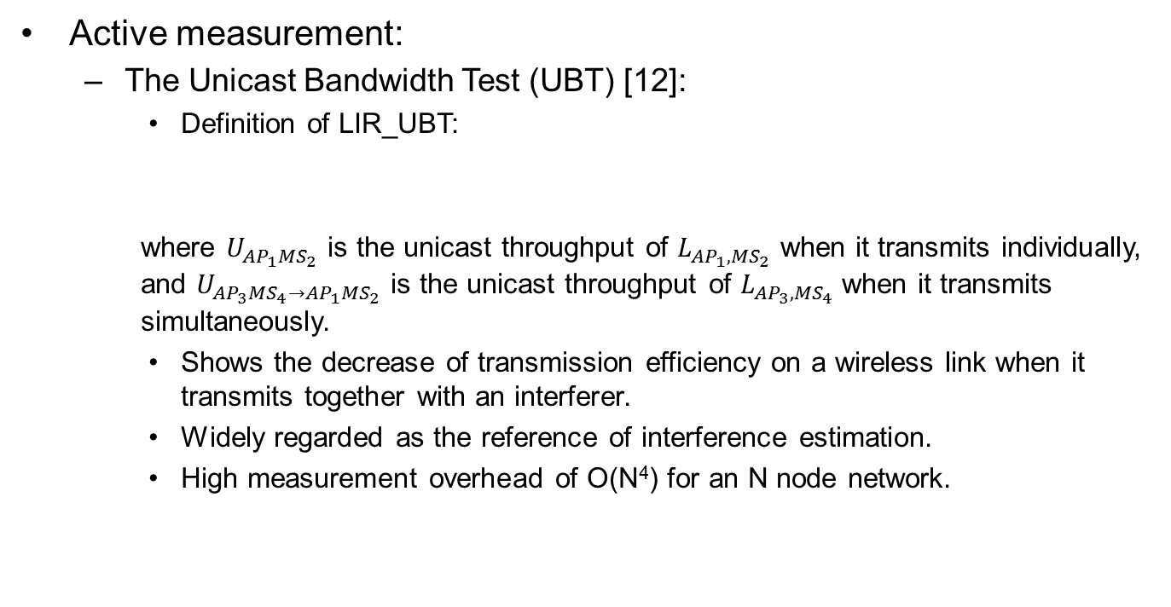
Measuring the LIR
Active measurement:
The Unicast Bandwidth Test (UBT) [12]:
Definition of LIR_UBT:
where $U_{{AP}_{1}{MS}_{2}}$ is the unicast throughput of $L_{{AP}_{1},{MS}_{2}}$ when it transmits individually, and $U_{{AP}_{3}{MS}_{4}→{AP}_{1}{MS}_{2}}$ is the unicast throughput of $L_{{AP}_{3}{,MS}_{4}}$when it transmits simultaneously.
Shows the decrease of transmission efficiency on a wireless link when it transmits together with an interferer.
Widely regarded as the reference of interference estimation.
High measurement overhead of O(N⁴) for an N node network.
Notes:
LIR can also be measured throng active and passive measurement.
The active way to measure is using the Unicast Bandwidth Test (UBT), which shows the decrease of the transmission efficiency on a wireless link when it transmits together with a possible interferer.
UBT is widely regarded as the reference of interference estimation.
However it requires high measurement overhead of 0(N4) for an N node network.

Slide 11

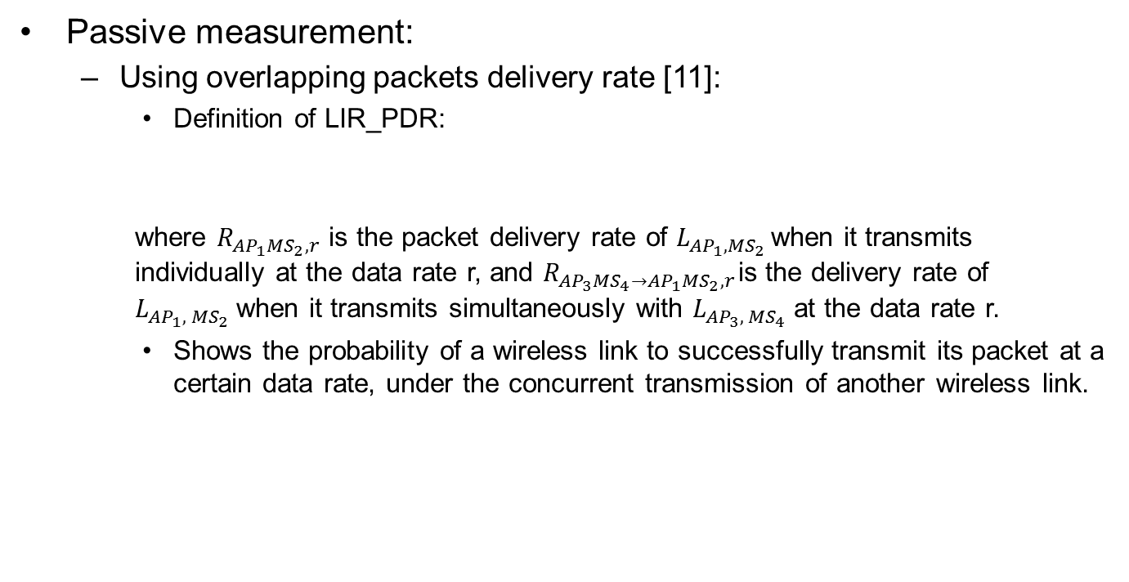
Measuring the LIR (cont.)
Passive measurement:
Using overlapping packets delivery rate [11]:
Definition of LIR_PDR:
where $R_{{AP}_{1}{MS}_{2},r}$ is the packet delivery rate of $L_{{AP}_{1}{, MS}_{2}}$ when it transmits individually at the data rate r, and $R_{{AP}_{3}{MS}_{4}→{AP}_{1}{MS}_{2},r}$ is the delivery rate of $L_{{AP}_{1}{, MS}_{2}}$when it transmits simultaneously with $L_{{AP}_{3}{, MS}_{4}}$at the data rate r.
Shows the probability of a wireless link to successfully transmit its packet at a certain data rate, under the concurrent transmission of another wireless link.
Notes:
For the passive measurement, the overlapping packet delivery rate is used to estimate LIR.
As shown in this fomular, the LIR_PDR indicates the probability of a wireless link to successfully transmit its packet at a certain data rate, under the concurrent transmission of another wireless link.

Slide 12
Contents
Introduction
Related Work
Problem Definition
System Design
Performance Evaluation
Conclusion

Slide 13
Problem Definition
Multiple Modulation and Coding Schemes (MCSs) are available to enable the trade-off between transmission data rates and link reliability.
Interference relation between links is affected by data rate [4, 10, 13]:
High data rate is more efficient in data transmission
Low data rate is more robust against interference
We aim to study the interference relation in dynamic environment, where APs transmission data rates are changing with the interference level.
[4] Huang, Jun, et al. "Unleashing exposed terminals in enterprise wlans: A rate adaptation approach." Proceedings of IEEE INFOCOM. 2014.
[10] Mahajan, Ratul, et al. "Analyzing the MAC-level behavior of wireless networks in the wild." Proceedings of ACM SIGCOMM. 2006.
[13] Ahmed, Nabeel, et al. "Measuring multi-parameter conflict graphs for 802.11 networks." Proceedings of ACM SIGCOMM. 2010.
Notes:
Motivation,
It is known that multiple MCSs are available to enable to trade-off between transmission data rates and link reliability.
The interference relation between wireless links is affected by the data rate used:
High data rate is more efficient in data transmission, while low data rate is more robust against intereference.
In this work, we aim to study the interference relation in dynamic environment, where Aps transmission data rate are changing with the interference level.

Slide 14
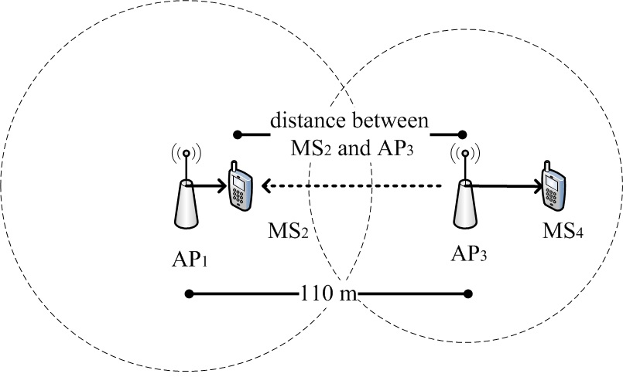
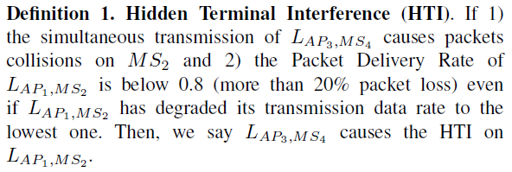
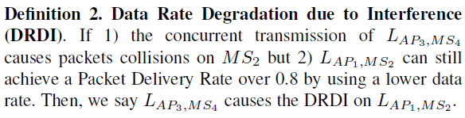
Types of Interferences
In this paper, we focus on the interferences among the downlink transmissions, from APs to MSs:
more than 20% packet loss at the lowest data rate.
Using lower data rate can still achieve over 80% packet delivery rate.
Notes:
In this paper, we focus on the interferences among the downlink transmissions, from AP to MS.
First ins the well-known hidden terminal interference, denoted as HTI: (you may briefly read the definition 1).
For HTI, it results in more than 20% packet loss even at the lowest data rate.
The other interference we consider, is called the Data Rate Degradation due to Interference. Which refers to the case, that (READ the definition 2).
Different from HTI, when a wireless link suffers DRDI, it can still achieve over 80% packet delivery rate when using a lower data rate.

Slide 15
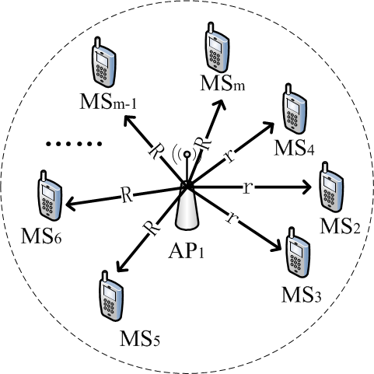
Why the DRD interference matter?
The influence of the DRD interference:
It will incur the well-known performance anomaly problem in 802.11 [14]
[14] Heusse, Martin, et al. "Performance anomaly of 802.11 b." Proceedings of IEEE INFOCOM, 2003.
Notes:
Well, you may ask, why the Data Rate Degradation Interference matters?
Actually, the DRDI will incur the well-known performance anomaly problem:
For instance, a WLAN consists of $m$ MSs in total, and $n$ of them suffer the DRD interference. Thus, for those $n$ ‘slow’ MSs, they may use the lowest data rate $r$ to transmit, whereas, the rest $m−n$ ‘fast’ MSs will use the higher data rate $R$. Due to the performance anomaly problem, though $R$ is much larger than $r$, the throughput of those $m−n$ ‘fast’ MSs are as low as those $n$ ‘slow’ MSs.

Slide 16
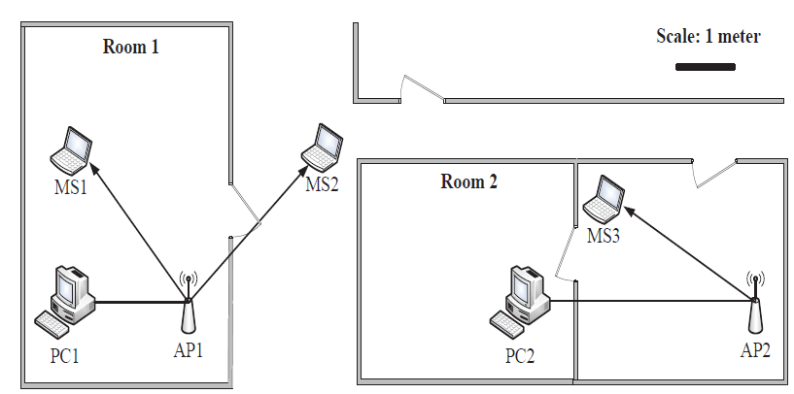
Experiment on the DRD interference
Testbed Setup
Two Access Points (AP)
Cisco WRT610.
Wired connection to PCs running Iperf.
Using the same channel in 2.5GHz.
IEEE 802.11n.
RTS/CTS disabled.
APs can’t carrier-sense each other.
Three mobile stations (MS):
MS1 associates with AP1 and without interference from AP2.
MS2 associates with AP1 but interfered by AP2.
MS3 associates with AP2 and interferes MS2.
Notes:
To investigate the significant throughput degradation caused by DRDI in a practical WiFi network, we set up an indoor testbed.
As shown in the figure, our experiment consists of two access points, using the same wireless channel in 2.5GHz in 802.11n.
Both of the APs are connected to PCs running Iperf.
We disable the RTS/CTS hand shake and fixed the transmission power of the APs to ensure they can’t carrier-sense each other.

Slide 17
Experiment on the DRD interference (cont.)
Testbed Setup
Iperf running on both PC1 and PC2 to generate downlink traffic:
UDP traffic.
30 Mbps traffic load.
Setup 20 minutes experiment:
0~10 minutes: Only AP1 is activated:
No interference.
10~20 minutes: Both AP1 and AP2 are activated:
Transmission from AP2 to MS3 will interfere MS2.
Notes:
Both of the APs are connected with PC running Iperf to generate downlink UPD traffic with 30Mbps traffic load.
We setup 20 minutes experiment, in the first 10 minutes, only AP1 is activated, thus, there is no interference on MS2.
And, in the later 10 minutes, we activate both AP1 and AP2, and thus, the transmission from AP2 to MS3 will interfere MS2.

Slide 18
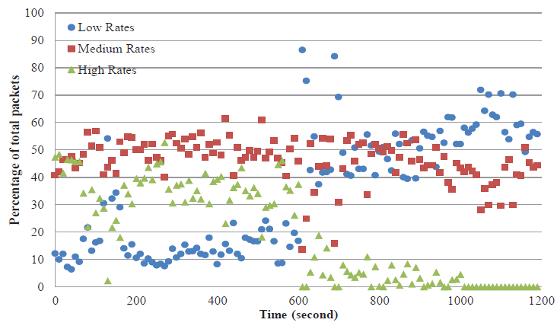
Measurement Results
Percentages of packets transferred at the interfered link
(AP1 to MS2) under different data rates:
Low Rates: 6.5, 13, and 19.5 Mbps.
Medium Rates: 26 and 39 Mbps.
High Rates: 52 Mbps and higher.
35% in High Rates
55% in Medium Rates
10% in Low Rates
5% in High Rates
45% in Medium Rates
50% in Low Rates
Notes:
This figure shows the percentages of packets transferred from AP1 to MS2 using each of those three data rate groups during the 20 minutes experiment.
We can see that in the first 600 seconds, the percentage of the packets transmitted using ‘High’ data rates is about 50 percent, and only around 10 percent of packets were transmitted using a ‘Low’ data rate.
However, after 600 seconds, when the DRDI happened, the percentage of High Rates decreased below 10 percent, whereas, the percentage of Low Rate increased and was above 50 percent. This data rate degradation happened
on MS2 caused the performance anomaly problem on MS1.

Slide 19
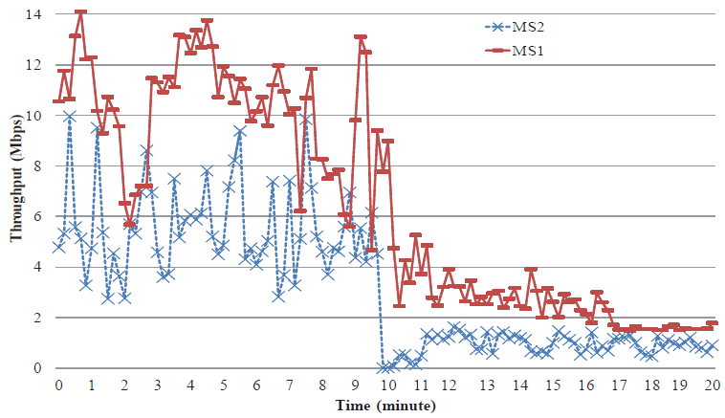
Measurement Results (cont.)
Throughputs of the mobile stations:
The throughputs of both MS1 and MS2
have decreased after 10 minutes.
Data rate degradation on MS2 caused the performance anomaly problem on MS1.
Notes:
This figure shows the throughput of the mobile stations.
In the first 10 minutes, the throughputs of MS1 and MS2 are around 10 Mbps and 6 Mbps, respectively.
After 10 minutes, the throughput of MS2 decreased to 1 Mbps due to the DRDI from AP2, and the throughput of MS1 also decreased to 3 Mbps due to the performance anomaly problem caused by the DRDI on MS2.
Thus, it is essential to detect and provide the DRDI information to the upper layer applications, such as the centralized scheduling system, to resolve the interference.

Slide 20
How well the PIE performs?
Simulation Setup:
Conduct simulations in QualNet simulator.
Hidden Terminal Topology:
Two wireless links: 2 APs and 2 MSs.
In the same channel in 802.11n.
RTS/CTS is disabled.
Auto-Rate-Fallback (ARF) is used to support rate adaptation.
Aims of evaluation:
How different passive interference estimation methods perform?
Notes:
To understand the problem in interference estimation in dynamic environments, we conduct extensive experiments in QualNet and use a simple interference topology. The topology consists of two APs and two MSs, and all of them share the same channel in 802.11n.
As shown in the figure, the solid lines with arrow represent the association relations between AP and MS, while the dashed line with arrow represents the potential interference relation between the transmission of AP1 and AP3.
The dashed circles indicate the transmission ranges of AP1 and AP2, which equals to 80 meters. The distance between two APs are 110 meters and they can’t carrier sense each other. Thus, the transmission from AP3 to MS4 may cause interference on the transmission from AP1 to MS2. However, it is clear to see that the interference levels are different depending on the distance between MS2 and AP3.

Slide 21

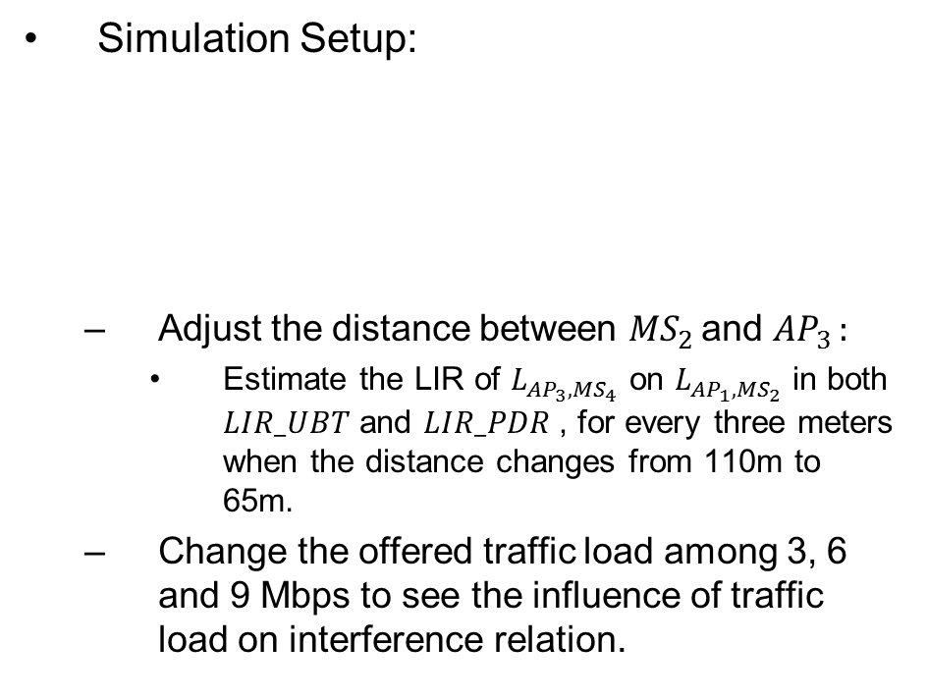
How well the PIE performs? (cont.)
Simulation Setup:
Adjust the distance between ${MS}_{2 }$and ${AP}_{3 }:$
Estimate the LIR of $L_{{AP}_{3},{MS}_{4}}$ on $L_{{AP}_{1},{MS}_{2}}$ in both ${LIR_UBT}_{ }$and $LIR_PDR$, for every three meters when the distance changes from 110m to 65m.
Change the offered traffic load among 3, 6 and 9 Mbps to see the influence of traffic load on interference relation.
change the distance
change the traffic load
Notes:
During the experiment, we adjust the distance between MS2 and AP3,
And estimate the LIR of link AP3, MS4 on link AP1 to MS2 using both LIR_UBT and LIR_PDR, for every three meters when the distance changes from 110m to 65m.
We also change the offered traffic load among 3,6,and 9 Mbps to see the influence of traffic load on the interference relation.

Slide 22
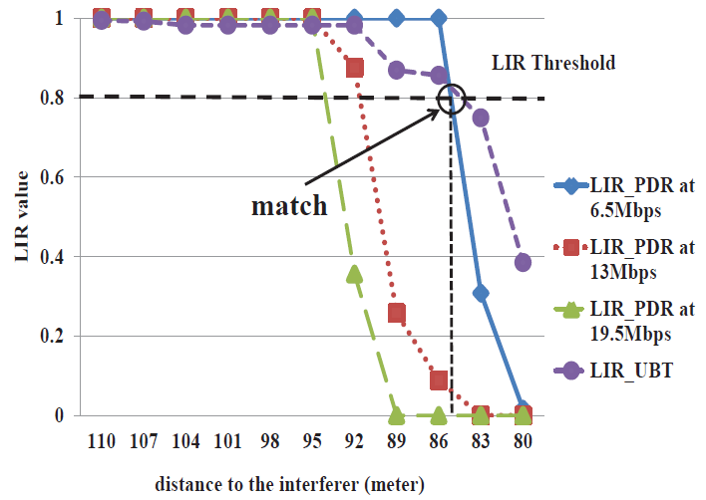
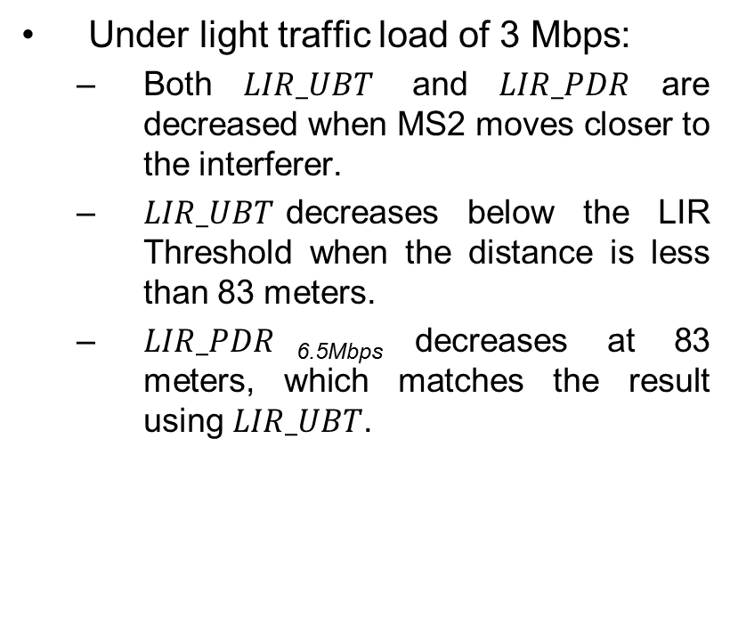
Results Analysis
Under light traffic load of 3 Mbps:
Both$LIR_UBT$and$LIR_PDR$are decreased when MS2 moves closer to the interferer.
$LIR_UBT$decreases below the LIR Threshold when the distance is less than 83 meters.
$LIR_PDR$_{6.5Mbps} decreases at 83 meters, which matches the result using $LIR_UBT$.
Notes:
This figure shows the distributions of LIR of link AP1 to MS2.
In case of 3 Mbps light traffic load:
We can observe that both $LIR_UBT$and$LIR_PDR$are decreased when MS2 moves closer to the interferer.
And LIR_UBT decreases below the LIR Threshold when the distance is less than 83 meters.
And LIR_PDR using 6.5Mbps decreases below the threshold at the distance of 83 meters, which matches the result of using LIR_UBT.

Slide 23
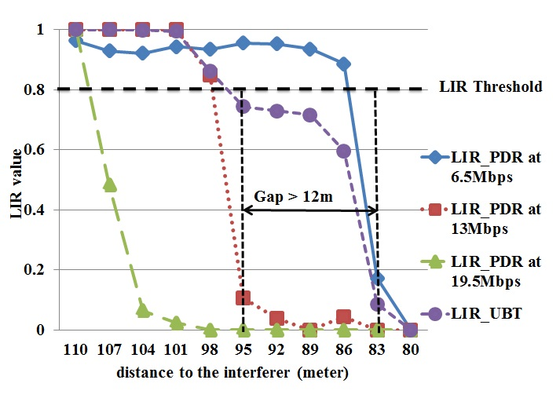
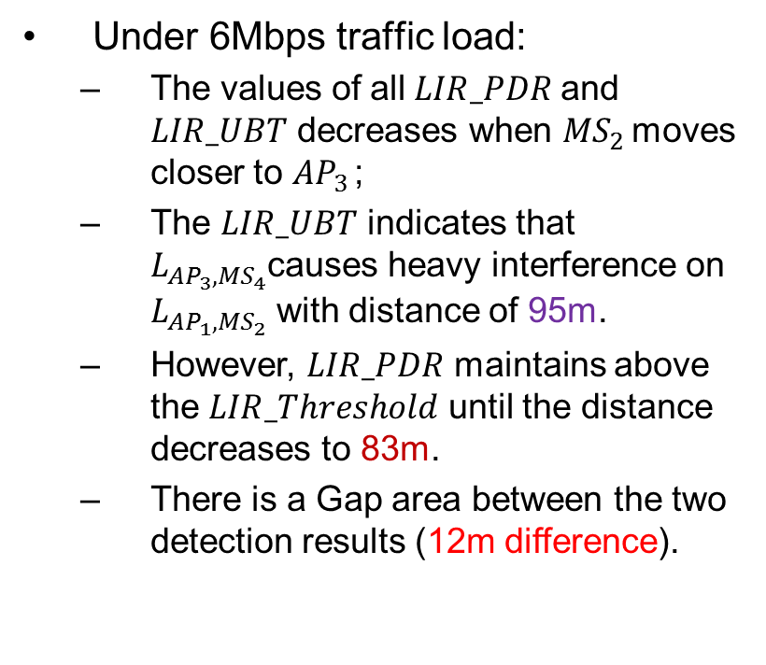
Results Analysis (cont.)
Under 6Mbps traffic load:
The values of all$LIR_PDR$ and $LIR_UBT$ decreases when ${MS}_{2 }$moves closer to ${AP}_{3 }$;
The $LIR_UBT$ indicates that $L_{{AP}_{3},{MS}_{4}}$causes heavy interference on $L_{{AP}_{1},{MS}_{2}}$ with distance of 95m.
However, $LIR_PDR$ maintains above the $LIR_Threshold$ until the distance decreases to 83m.
There is a Gap area between the two detection results (12m difference).
Notes:
In case of medium traffic load, with the increasing of the traffic load, more collisions happen at MS2. Thus, the LIR UBT shows that Link AP3 MS4 will cause heavy interference on link AP1 to MS2
from a position much earlier than that in the light traffic load case.
We can see that the LIR UBT drops below the LIR Threshold when the distance is around 95 meters. However, LIR_PDR at 6.5Mbps still maintains above the LIR Threshold until the distance decreases to 83 meters.
The UBT estimates that link AP1 to MS2 suffers interference from link AP3 to MS4 when the distance is 95 meters, whereas, the PIE shows the interference starts from 83 meters, which is a 12
meters difference. Thus, there is a gap area in which the estimation results of the UBT and PIE are different.

Slide 24
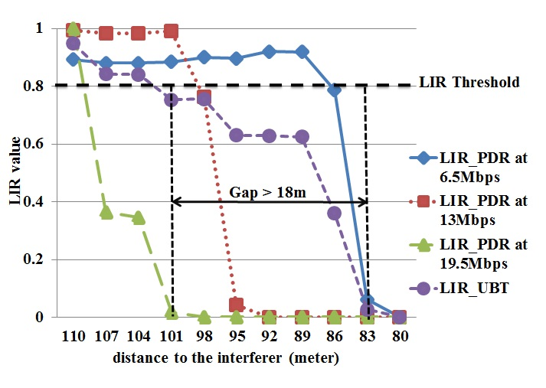
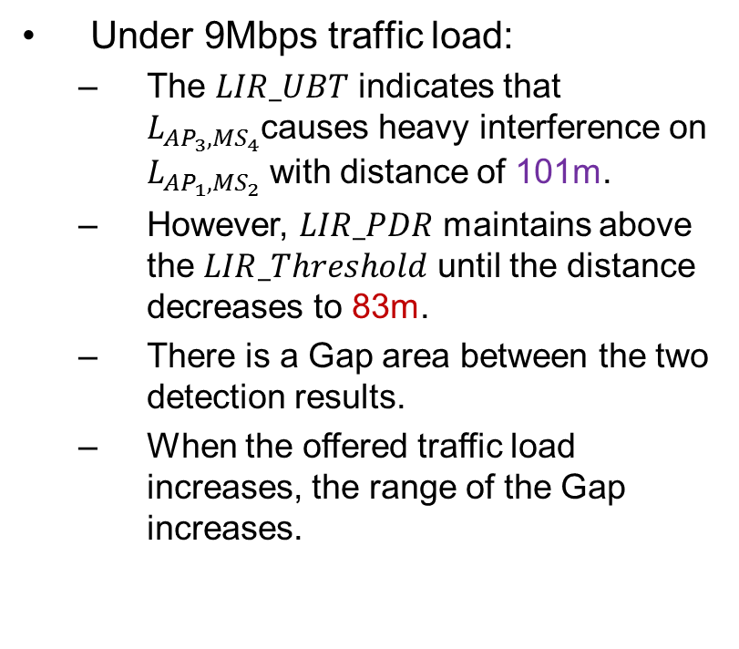
Results Analysis (cont.)
Under 9Mbps traffic load:
The $LIR_UBT$ indicates that $L_{{AP}_{3},{MS}_{4}}$causes heavy interference on $L_{{AP}_{1},{MS}_{2}}$ with distance of 101m.
However, $LIR_PDR$ maintains above the $LIR_Threshold$ until the distance decreases to 83m.
There is a Gap area between the two detection results.
When the offered traffic load increases, the range of the Gap increases.
Notes:
In case of heavy traffic load, the result is similar to that in the medium traffic load. We can notice that the LIR UBT drops below the LIR Threshold when the distance
is around 101 meters. But, the value of LIR_PDR at 6.5Mbps can maintain above the LIR Threshold until the distance is smaller than 83 meters. In this case, the range of the gap area increases
to 18 meters.

Slide 25

How well the PIE performs?
Observation:
Applying the $LIR_PDR$ at a single data rate in PIE can’t detect the DRD Interference. Though UBT can detect the DRDI, it is not applicable due to its large estimation overhead.
Notes:
Note that, using the LIR PDR at a single rate in PIE can detect the HTI but fails to detect the DRDI. Because the DRDI happens in the gap area as shown in the above examples, in which the LIR_PDR at 6.5Mbps is still above
the LIR Threshold. On the other hand, though the UBT can clearly detect both the HTI and DRDI using the LIR UBT, it is not applicable in practice due to its large computing overhead, as mentioned before.
In this study, we aim to address the problem in PIE and proposed our method to resolve this.

Slide 26
Contents
Introduction
Related Work
Problem Definition
Proposed System: AMONET Performance Evaluation
Conclusion

Slide 27
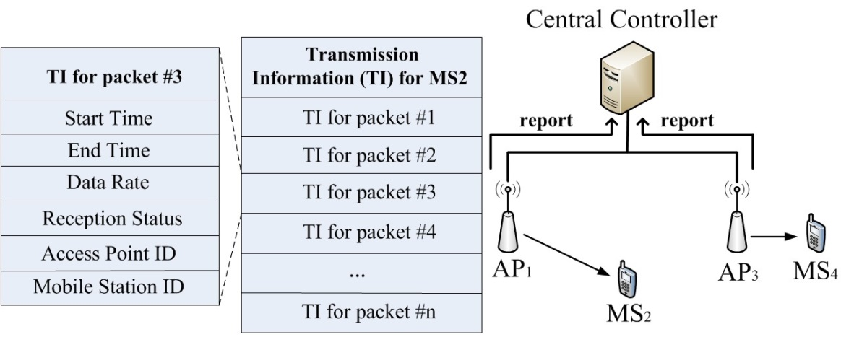
System Overview
AMONET Architecture
AMONET requires the APs to record the Transmission Information (TI) for every packet they have transmitted.
APs periodically send the collected TIs to the central controller, where the TIs will be merged and analyzed.
Notes:
Following the trend in the existing passive interference estimation, AMONET is a centralized system, it requires the APs to passively record the Transmission Information for every packet they have transmitted.
The information includes:
An accurate timestamp showing the transmission start-time and end-time of the packet;
The data rate the packet was transmitted;
The packet’s reception status, which shows if the packet has been successfully transmitted;
Also, the ID of the access point and the mobile station;
APs will periodically send the collected TIs to the central controller, where those information will be merged and analyzed.

Slide 28
System Design
Types of Interferences:
We only consider the conflicts among the downlink transmission which occupies around 85% of the entire traffic [15,16].
AMONET can detact three types of interference:
Carrier-Sense (CS) interference by Algorithm 1
Hidden Terminal Interference (HTI) and Data Rate Degradation Interference (DRDI) by Algorithm 2
[15] M. Rodrig, et al, “Measurement-based characterization of 802.11 in a hotspot setting,” Proceedings of ACM SIGCOMM E-WIND, 2005.
[16] J. Eriksson, S. Agarwal, P. Bahl, and J. Padhye, “Feasibility study of mesh networks for all-wireless offices,” Proceedings. of ACM Mobisys, 2006
Notes:
In AMONET, we focus on the conflicts among the downlink transmission which has been reported that occupies around 85% of the entire traffic.
We consider three types of interference:
Carrier-sense interference,
Hidden terminal interference,
Data rate degradation interference.

Slide 29
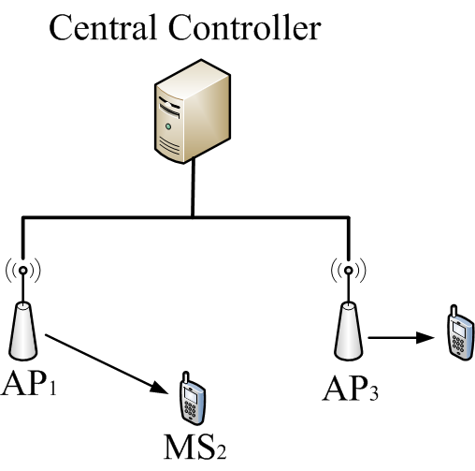
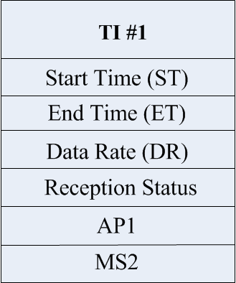
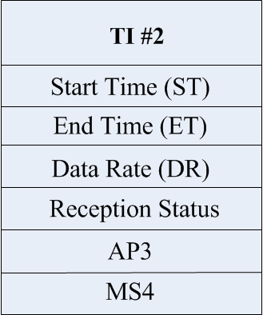




Detection of the CS Interference
The CS interference between APs:
Controller uses the timestamps to calculate the packet overlapping relation:
$$TI\#1.ST<TI\#2.ST$$
$$TI\#1.ET>TI\#2.ST$$
${AP}_{3}$ can’t carrier-sense ${AP}_{1}$
Notes:
To infer the CS interference, the controller will merge and sort the collected TIs in the order of the transmission start time based on the same timeline. Note that, this requires
the times at both the APs and controller are synchronized, which can be achieved using the Precision Time Protocol.
After sorting, the controller analyzes the overlapping relation between the APs’ packet transmissions. Then, based on the packets overlapping relationship, the controller can infer the APs’ Carrier Sense relation.
For example, if the start time of TI1 is earlier than TI2, and the end time of TI1 is also earlier than TI2, then we say TI2 overlaps TI1. If this overlapping frequently happens, then, we can infer than AP3 can’t carrier sense AP1.

Slide 30









Detection of the CS Interference (cont.)
The CS interference between APs:
${AP}_{3}$ can’t carrier-sense ${AP}_{1}$
$$TI\#1.ST<TI\#2.ST$$
$$TI\#1.ET>TI\#2.ST$$
${AP}_{1}$ can’t carrier-sense ${AP}_{3}$
$$TI\#2.ST<TI\#1.ST$$
$$TI\#2.ET>TI\#1.ST$$
${AP}_{1}$ and ${AP}_{3}$ carrier-sense each other
Notes:
Similarly, we can infer the other 3 cases of carrier-sense relation.

Slide 31
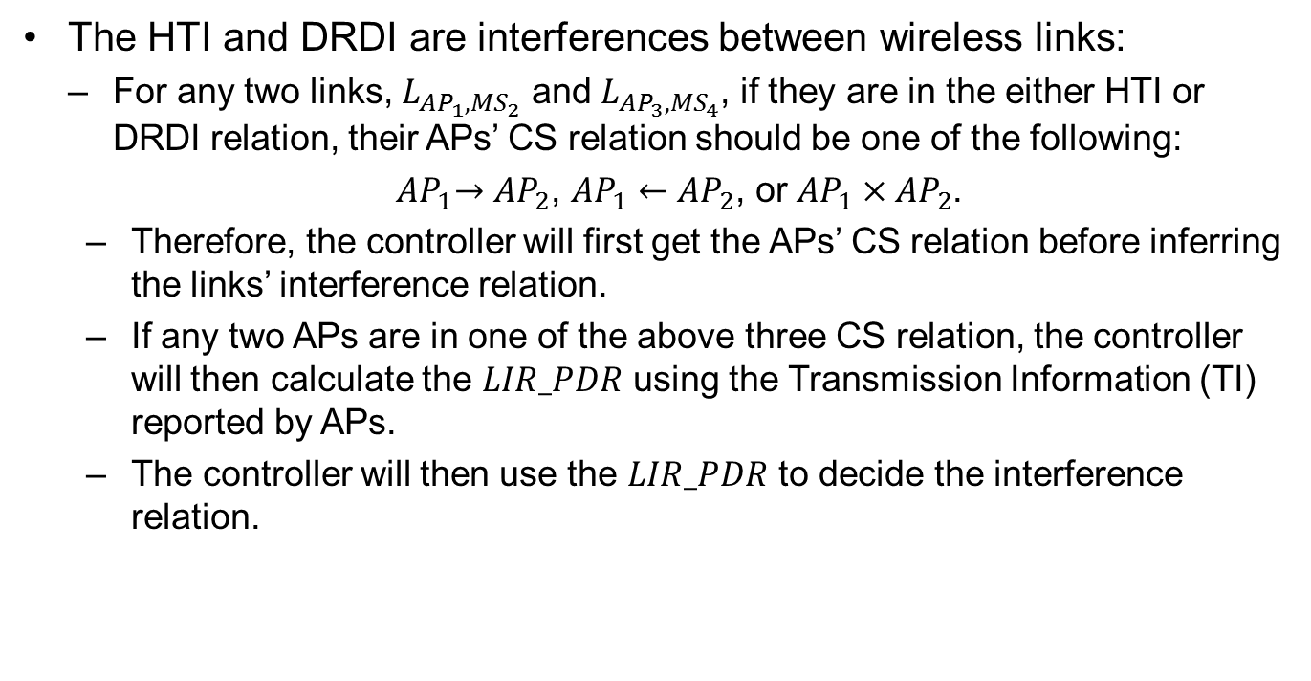
Detection of HTI and DRDI
The HTI and DRDI are interferences between wireless links:
For any two links, $L_{{AP}_{1},{MS}_{2}}$ and $L_{{AP}_{3},{MS}_{4}}$, if they are in the either HTI or DRDI relation, their APs’ CS relation should be one of the following:
${ AP}_{1}→{AP}_{2}$, ${AP}_{1}←{AP}_{2}$, or ${AP}_{1}×{AP}_{2}$.
Therefore, the controller will first get the APs’ CS relation before inferring the links’ interference relation.
If any two APs are in one of the above three CS relation, the controller will then calculate the $LIR_PDR$ using the Transmission Information (TI) reported by APs.
The controller will then use the $LIR_PDR$ to decide the interference relation.
Notes:
The prerequisite for any two links in the HTI or DRDI relation is that at least one of APs can’t carrier sense the other one. Therefore, to detect the links’ interference relation,
the controller gets the Carrier Sense relations between all the Aps, and check, for any two links, if their APs’ CS relation is one of the following:
If any two APs are in one of the above three CS relation, the controller will then calculate the LIR_PDR using the Transmission Information reported by Aps, and use the LIR_PDR to decide the interference relation.

Slide 32
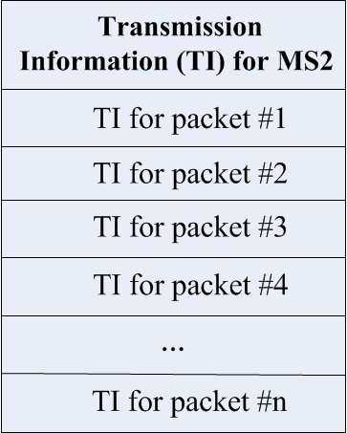
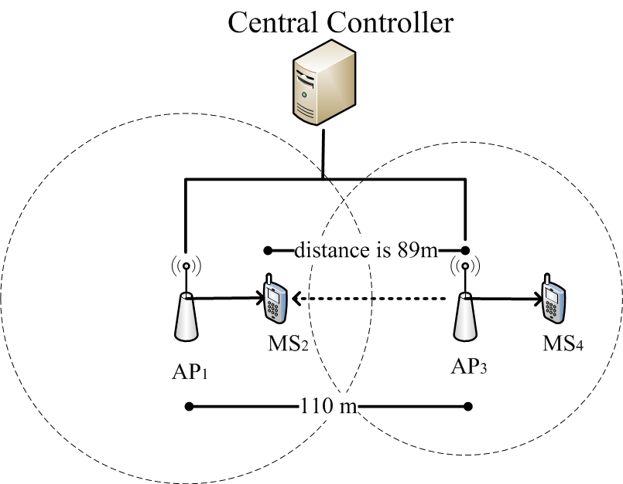
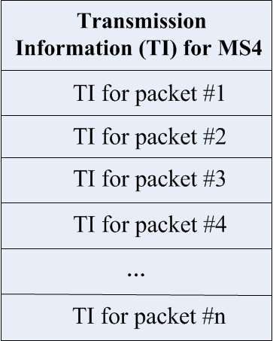

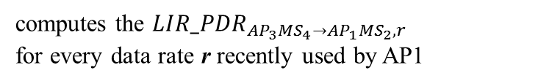
Detection of HTI and DRDI (cont.)
Example:
Recall our previous scenario, and set the distance with 89 meters. Thus, $L_{{AP}_{3},{MS}_{4}}$ will cause DRDI interference on $L_{{AP}_{1},{MS}_{2}}$.
computes the ${LIR_PDR}_{{AP}_{3}{MS}_{4}→{AP}_{1}{MS}_{2},r}$
for every data rate r recently used by AP1
Notes:
As an example, recall our previous scenario, in which, the distance is 89 meters. And, link AP3 to MS4 will cause the DRDI interference on Link AP1 to MS2.

Slide 33




Detection of HTI and DRDI (cont.)
Example:
In this case, controller computes the ${LIR_PDR}_{{AP}_{3}{MS}_{4}→{AP}_{1}{MS}_{2},r}$ for all the data rate recently used by $L_{{AP}_{1},{MS}_{2}}$:
${LIR_PDR}_{{AP}_{3}{MS}_{4}→{AP}_{1}{MS}_{2},6.5Mbps}$ = 0.936
${LIR_PDR}_{{AP}_{3}{MS}_{4}→{AP}_{1}{MS}_{2},13Mbps}$ = 0.000
${LIR_PDR}_{{AP}_{3}{MS}_{4}→{AP}_{1}{MS}_{2},19.5Mbps}$ = 0.000
6.5Mbps
> $LIR_Threshold$
< $LIR_Threshold$
19.5Mbps
Checks the value of $LIR_PDR$ from the lowest data rate (6.5Mbps) to the highest:
if ${LIR_PDR}_{{AP}_{3}{MS}_{4}→{AP}_{1}{MS}_{2},6.5Mbps}< LIR_Threshold$: return HTI
else if ${LIR_PDR}_{{AP}_{3}{MS}_{4}→{AP}_{1}{MS}_{2},13Mbps}< LIR_Threshold$: return DRDI
In this case, the interference is DRDI!
Notes:
In this case, controller computes the LIR_PDR of link AP3 to MS4 on link AP1 to MS2 for all the data rate recently used by Link AP1 to MS2.
Then, controller checks the value of LIR_PDR from the lowest data rate to this highest:
If the LIR_PDR at 6.5 Mbps is lower than the LIR threshold, then, the controller checks the value of the higher data rate.
In our case, the LIR_PDR at 13Mbps is lower than the threshold, then it returns DRDI as the result.

Slide 34
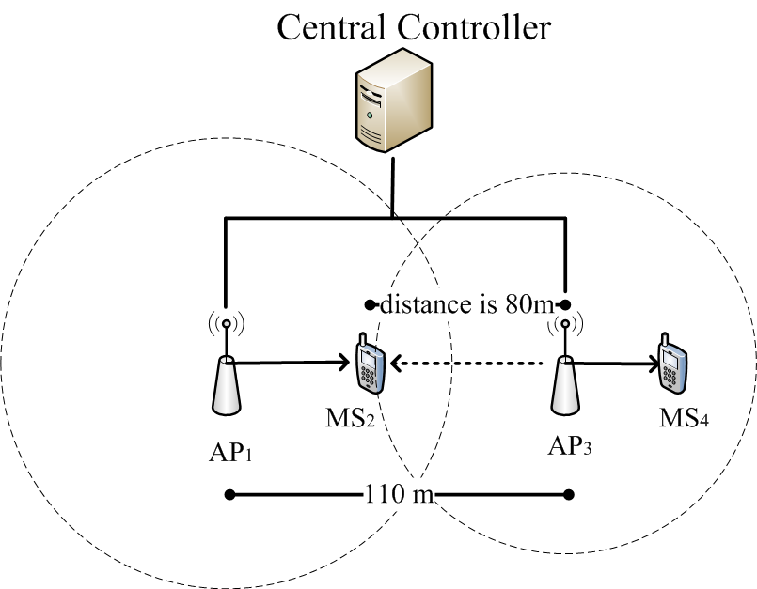

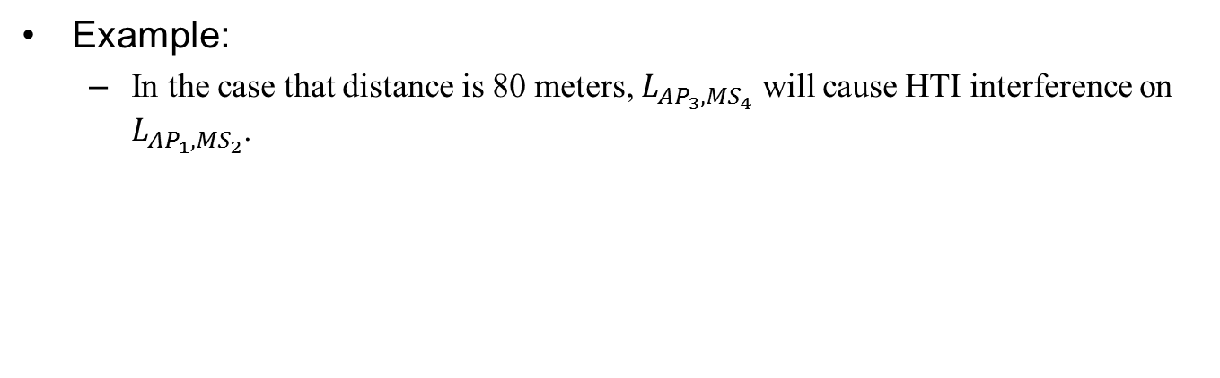
Detection of HTI and DRDI (cont.)
Example:
In the case that distance is 80 meters, $L_{{AP}_{3},{MS}_{4}}$ will cause HTI interference on $L_{{AP}_{1},{MS}_{2}}$.
Notes:
In the case that distance is shorter than 80 meters, link AP3 to MS4 will cause the HTI interference on Link AP1 to MS2.

Slide 35



Detection of HTI and DRDI (cont.)
Example:
Similarly, controller computes the ${LIR_PDR}_{{AP}_{3}{MS}_{4}→{AP}_{1}{MS}_{2},r}$ for all the data rate recently used by $L_{{AP}_{1},{MS}_{2}}$:
${LIR_PDR}_{{AP}_{3}{MS}_{4}→{AP}_{1}{MS}_{2},6.5Mbps}$ = 0.000
${LIR_PDR}_{{AP}_{3}{MS}_{4}→{AP}_{1}{MS}_{2},13Mbps}$ = 0.000
${LIR_PDR}_{{AP}_{3}{MS}_{4}→{AP}_{1}{MS}_{2},19.5Mbps}$ = 0.000
6.5Mbps
< $LIR_Threshold$
19.5Mbps
Checks the value of $LIR_PDR$ from the lowest data rate (6.5Mbps) to the highest:
if ${LIR_PDR}_{{AP}_{3}{MS}_{4}→{AP}_{1}{MS}_{2},6.5Mbps}< LIR_Threshold$: return HTI
In this case, the interference is HTI!
Notes:
Similarly, controller computes the LIR_PDR for all the data rate recently used by Link AP1 to MS2, and check from the lowest data rate.
Here, in this case, the LIR_PDR at 6.5mbps is 0, which is lower than the threshold, thus, the controller can detect this as the HTI inference.

Slide 36
Contents
Introduction
Related Work
Problem Definition
System Design
Performance Evaluation
Conclusion

Slide 37
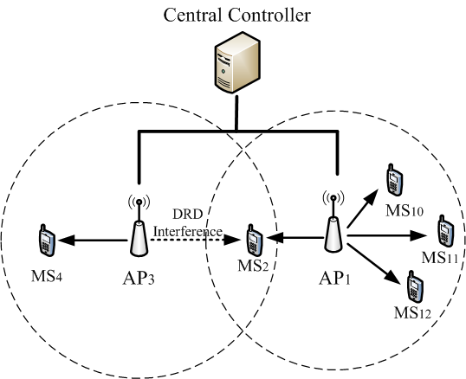
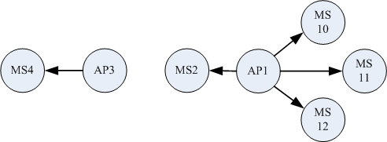
Performance Evaluation
A simple scenario: DRDI Only
The controller runs a centralized scheduling algorithm, called Centaur [5].
We use both AMONET and PIE to create a Conflict Graph, and use it as input of Centaur.
In the case of AMONET: we detect the DRDI, so the CG will be:
In the case of PIE: it can’t detect the DRDI, the CG will be:
We will show the throughput of the each wireless links, and the aggregate throughput.
Conflict Graph
Experiment in simple scenario
Notes:
We conducted extensive simulations in the QualNet simulator in order to prove that the interference information provided by AMONET can benefit the centralized scheduling algorithm more than previous works.
We start with a simple scenario, in which only DRDI interference exists. As shown in this figure, the transmission from AP3 to MS4 will cause DRDI on the link AP1 to MS2.
The controller runs a centralized scheduling algorithm, called Centaur. And we implement both AMONET and PIE to create the conflict graph, and use the generated conflict graph as input of the centralized scheduling algorithm Centaur.
In case of PIE, it can’t detect the DRDI interference, the conflict graph will be this, which indicates no interference in this network.
On the other hand, AMONET can detect the DRDI link AP3 to MS4 on the link AP1 to MS2. We will show the throughput of the each wireless links, and the aggregate throughput.

Slide 38
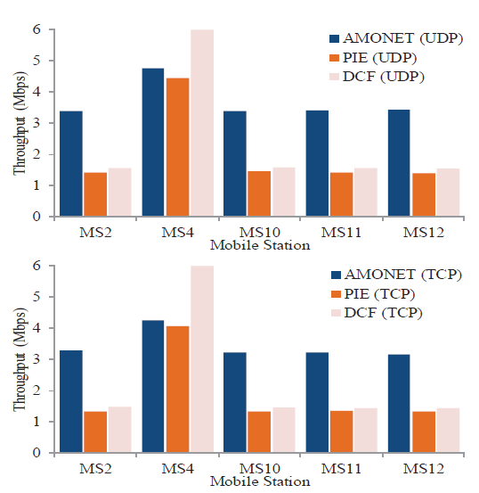
Performance Evaluation (cont.)
Experiment results:
In PIE and DCF, DRDI interference on MS2 will cause throughput degradation on all the contention links.
AMONET avoids the DRDI interference and increases the throughput
Experiment in simple scenario
Notes:
This figure shows the throughput for each of the MSs, due to the DRDI caused by the interference from link AP3 to MS4 on link AP1 to MS2 , the throughput of MS2 is less than 2 Mbps. Moreover, the performance anomaly problem induced by the rate degradation affected all the other three MSs that associate to AP1, and made the throughputs of those MSs are as low as that of MS2. In case of Centaur integrated with PIE (PIE-Centaur), because PIE can’t detect the DRDI, Centaur performs no better than DCF. On the other hand, when integrated with AMONET, Centaur can allocate different time slots to the transmissions of LAP3;MS4 and LAP1;MS2 , which mitigates the interference occurs on MS2. As a result, Link AP1 to MS2 will be free from the DRDI from Link AP3 to MS4 , and thus, will increase the throughput on all the other MSs.

Slide 39
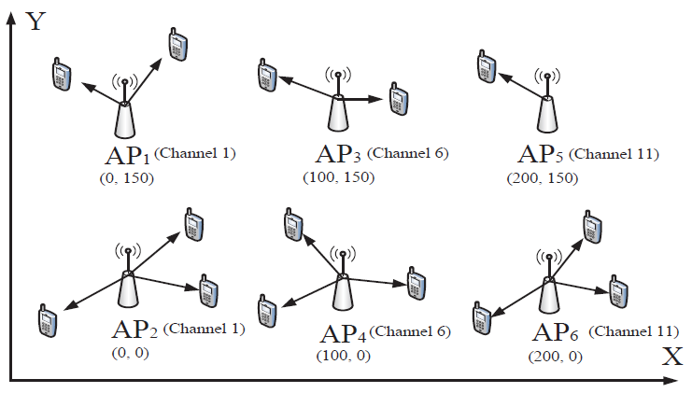
Performance Evaluation (cont.)
Complex scenario: DRDI + HTI
Consists of 6 APs
Every two adjacent APs use one of the three orthogonal channels in 2.4GHz.
Out of the carrier-sensing range of each other: DRDI or HTI interference.
Each AP associated with 2~3 MSs.
14 wireless links and 25% of the links suffer either DRDI or HTI interference.
Experiment in simple scenario
Notes:
Now evaluate AMONET in a complex scenario which includes both HTI and DRDI.
As shown in this figure, our topology consists of six APs and every two adjacent APs use one of the three orthogonal channels in 2.4 GHz, and with a distance of 100 or 150 meters, so that
they are out of the carrier sensing range of each other. We distribute 14 MSs and associate them to each of the APs, as shown in Figure, each of the APs may have one to three MSs.
Note that, in each of the scenarios we used, the ratio of links suffering either the HTI or DRDI is about 25%, which means around four links among those 14 links are suffering one of
those two interferences.

Slide 40
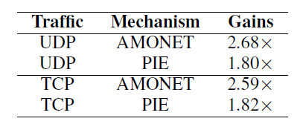
Performance Evaluation (cont.)
Experiment results:
Aggregate throughput Gains over DCF:
PIE can improve the system throughput by avoiding the HTI interference. (80% increment in both cases)
When DRDI exists, overall throughput still decreases due to performance anomaly problem.
AMONET can avoid both HTI and DRDI:
Achieving 160% increment in both cases over DCF
Achieving 49% and 42% improvement over PIE in UDP and TCP, respectively.
Notes:
This Table shows the throughput gains of Centaur over DCF for the complex scenario using AMONET and PIE, respectively.
This Table shows the aggregate throughput gains of Centaur on the interfered links. The results indicate that, with AMONET, Centaur can achieve a throughput gain more than
2.50 on those interfered AP-to-MS links over DCF, while with PIE, Centaur can only achieve a 1.80 gain over the DCF. This clearly shows that Centaur can largely increase the throughput of the interfered links by using AMONET. In addition, in all the cases, Centaur can achieve better fairness when using AMONET, compare with PIE and DCF.

Slide 41
Contents
Introduction
Related Work
Problem Definition
System Design
Performance Evaluation
Conclusion and Further Works

Slide 42
Conclusion and Further works
We presented a detail measurement study of the interference detection in dynamic Wi-Fi environment.
We presented AMONET and integrated it with a centralized scheduling system to detect and mitigate interferences.
Results demonstrated that AMONET can greatly benefits the centralized scheduling system and achieves higher system throughput than previous works.
We will implement AMONET in testbed to evaluate its performance and accuracy in interference detection.
Experiment in simple scenario

Slide 43
Thanks for your attention! Any Questions?

